Slide 1
Olha Novikova

Slide 2
"Waiting for Godot"
based on the play by S. Becket, directed by A. Zamanska, Kyiv Experimental Theater Studio National University of Kyiv Mohyla Academy (1996)

Slide 6
"Cola Icy"
based on the play by L. Chupis, directed by O. Shaparenko,
Kyiv National Academic, the National Center for Theater Arts named after Les Kurbas (2007)

Slide 7
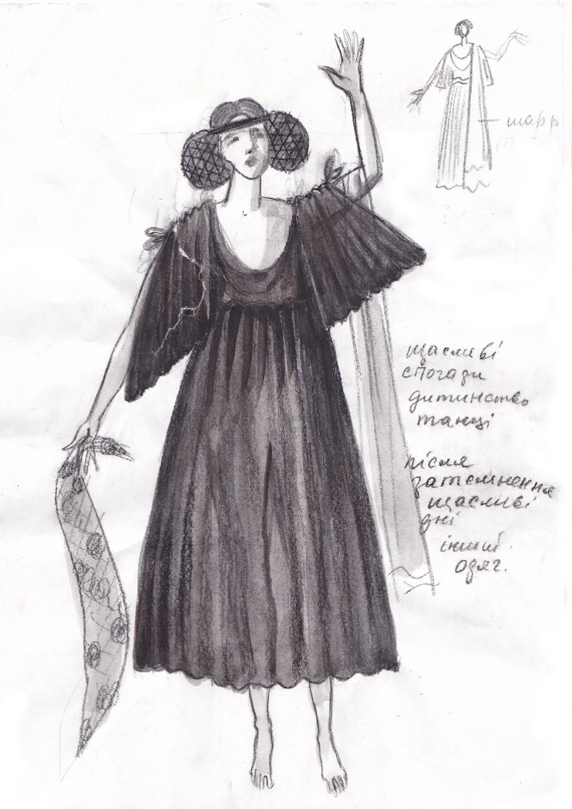
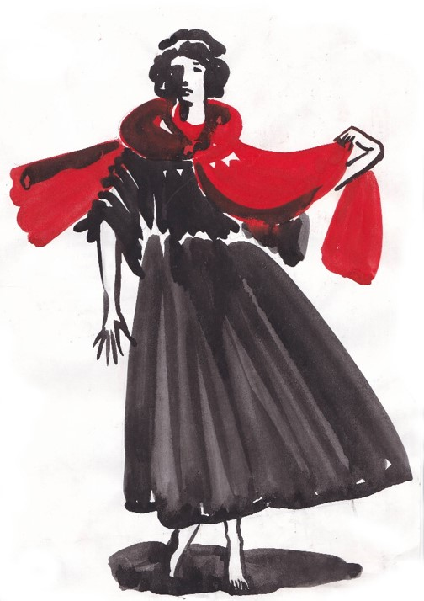

Slide 10
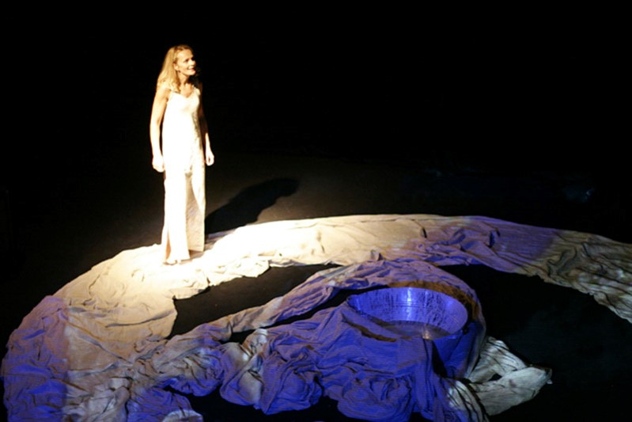

Slide 11
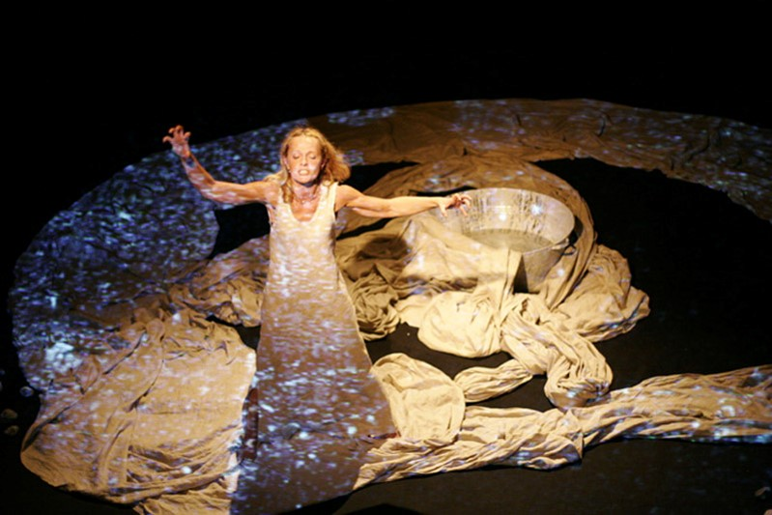

Slide 12
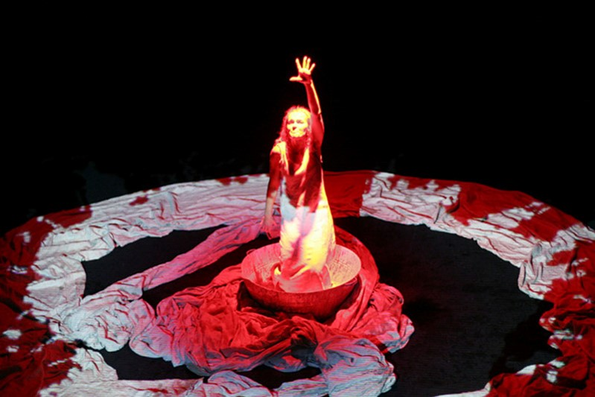

Slide 13
"Action"
based on the play by C. Shepard director by V. Marguet (France),
the National Center for Theater Arts named after Les Kurbas (2007)

Slide 16
"Othello"
(costume designer)
based on the play by L. Itselev,
directed by A. Kantsedailo,
Dnipro National Academic Ukrainian Music and Drama Theater named after T. G. Shevchenko (2010)

Slide 18
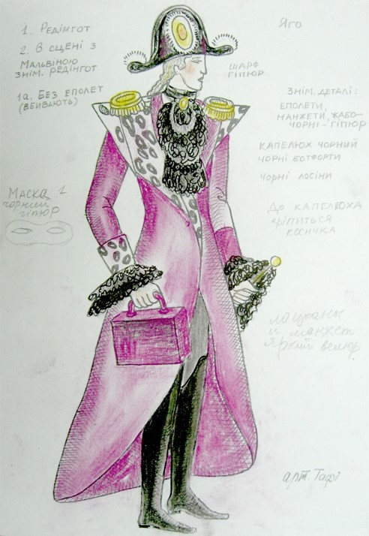
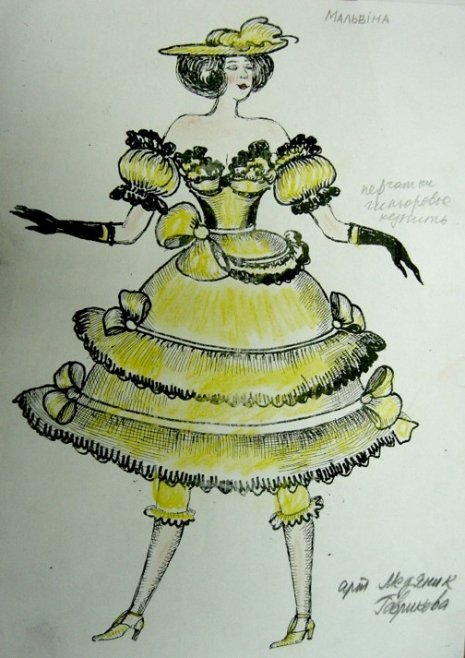

Slide 19
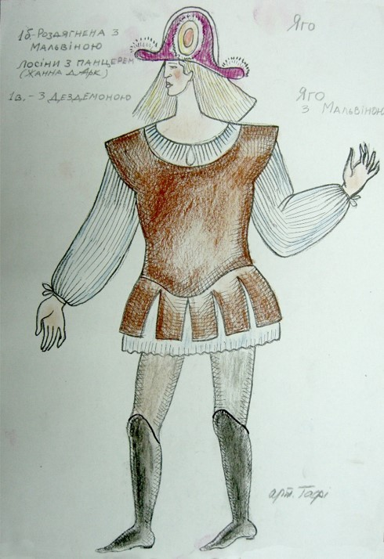
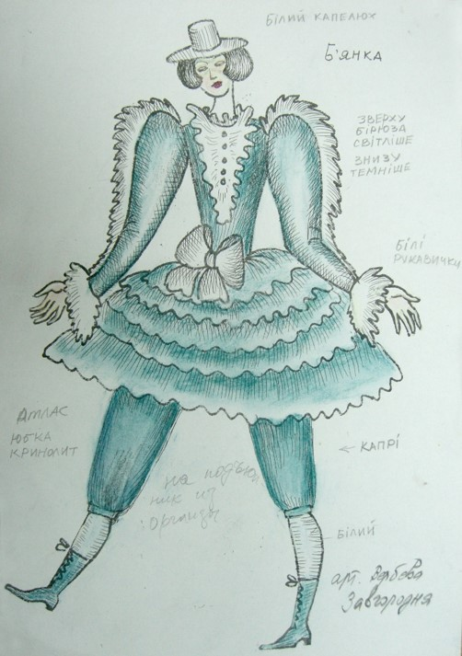

Slide 20
"Wild Honey in the Year
of the Black Rooster"
based on the play by O. Mykolaichuk,
director by O. Shaparenko, the National Center for Theater Arts named after Les Kurbas (2010)

Slide 22
"The Abyss Calls the Abyss"
based on the play by O. Tanyuk
director by S. Suknenko,
the National Center for Theater Arts named after Les Kurbas (2015)

Slide 28
"Lakshmi's Dream, who saw Vishnu in his dream, or a meditation on the theme of the play of the Gods"
based on the play by O. Tanyuk, director by M.Grynyshyn, the National Center for Theater Arts named after Les Kurbas (2019-2020)

Slide 36
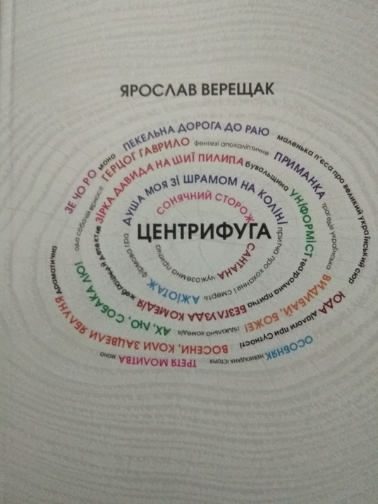
Designing the collection "Newest French Play" (2003)
Designing the сollections of plays
by Y. Vereshchak "Centrifuge"
(2018)
The first anthology of the modern biographical drama
"The Secret of Being"
(2015)

Slide 37
Designing the сollections "Agiotage"
Designing the сollections
"Rain in the square aquariums"

Slide 38
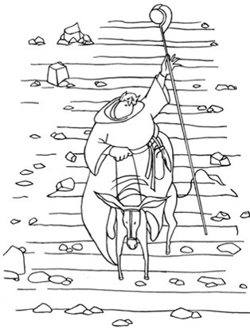
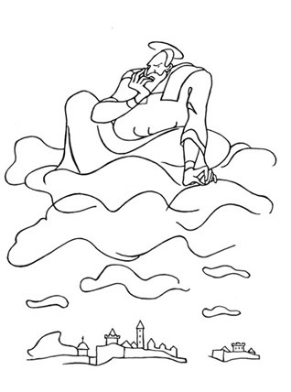
Illyustraions Voltaire "Maid of Orleans"

Slide 39
From "The Ukrainian Vertep" series, 1991, plywood, tempera 33х54 cm

Slide 40
Myron Retold the Red Mare's Dream, 1991, watercolor on paper, 40х47 cm

Slide 41
The Holidays Begin (inspired by Thomas Mann's "Death in Venice"), 1992, tempera on plywood, 39х60 cm

Slide 42
Traveler (inspired by Lina Kostenko's "Snow in Florence"), 1992, oil on plywood, 27х36

Slide 43
Greek Motifs, 1991, watercolor and gouache on paper, 41х59 cm

Slide 44
Maxwell Anderson's Motifs, 1993, watercolor and gouache on paper, 24х39 cm

Slide 45
Set design for Hoffmann's play "The Golden Pot", 2005, oil on canvas, 50х60 cm

Slide 46
The Grandma Is Hard to Please, 2014, watercolor on paper, 37х24 cm, 37х24 cm

Slide 47
The Dreamy Harlequin, 2015, oil on canvas, 50х50 cm

Slide 48
Tbilisi Biennale of Stage Design, 2022

Slide 50
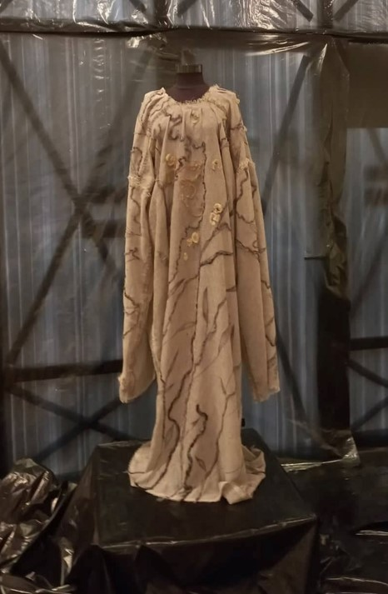

Slide 51
Thank you for attention

