Slide 3
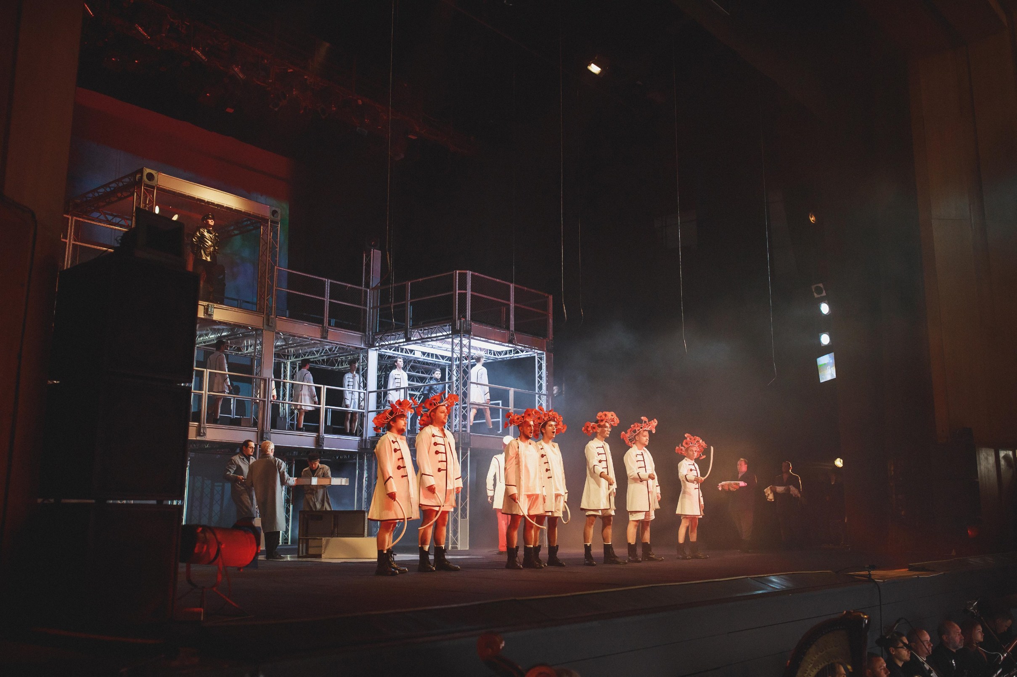
OLESYA HOLOVACH

Slide 4
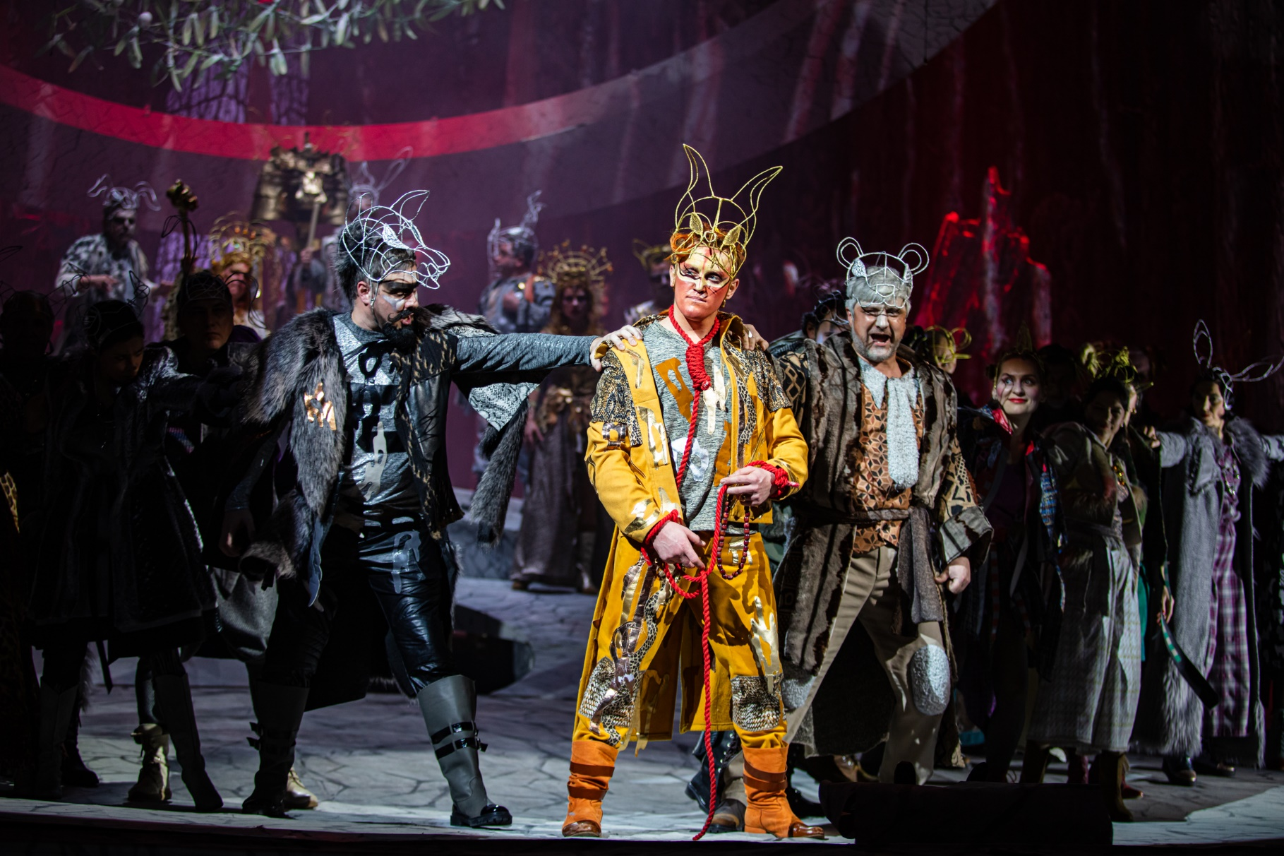
HANNA IPATIEVA

Slide 5
KATERYNA MARKUSH

Slide 6
MARIYA KRUTOHOLOVA

Slide 7
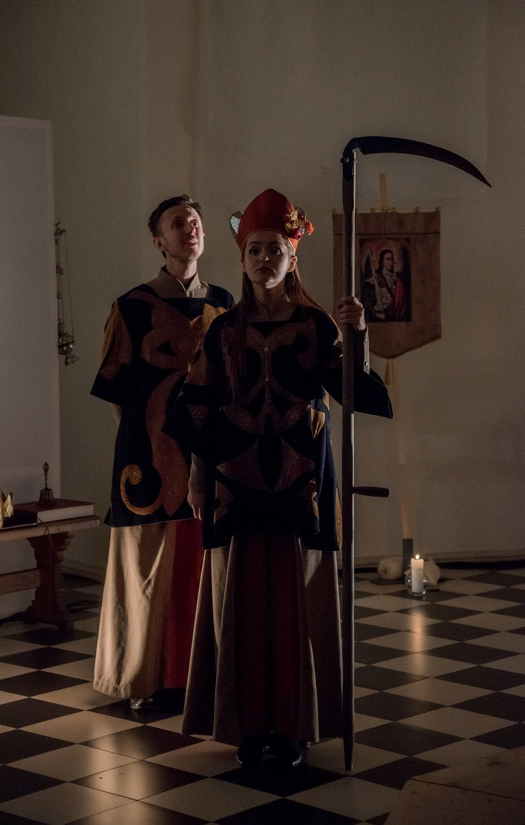
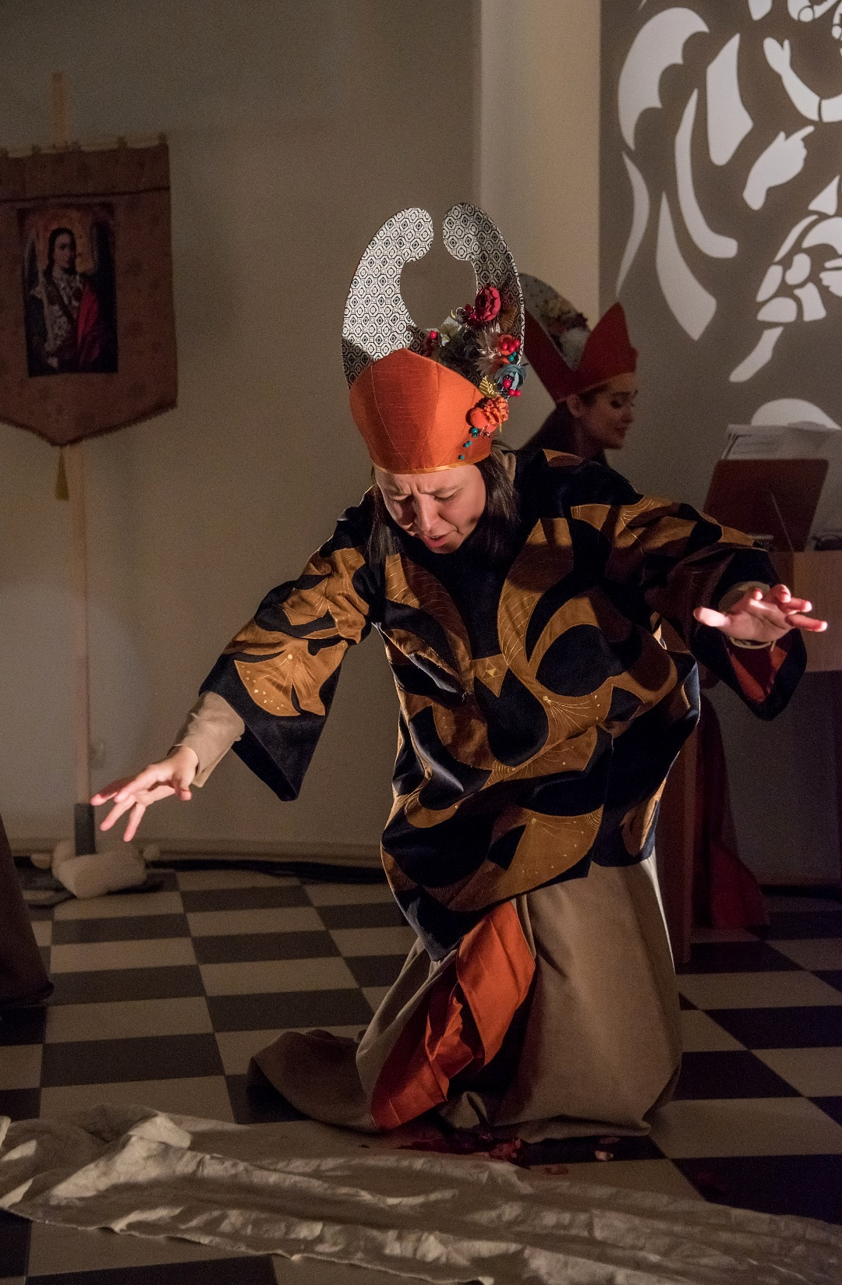
OLENA POLISHCHUK

Slide 11
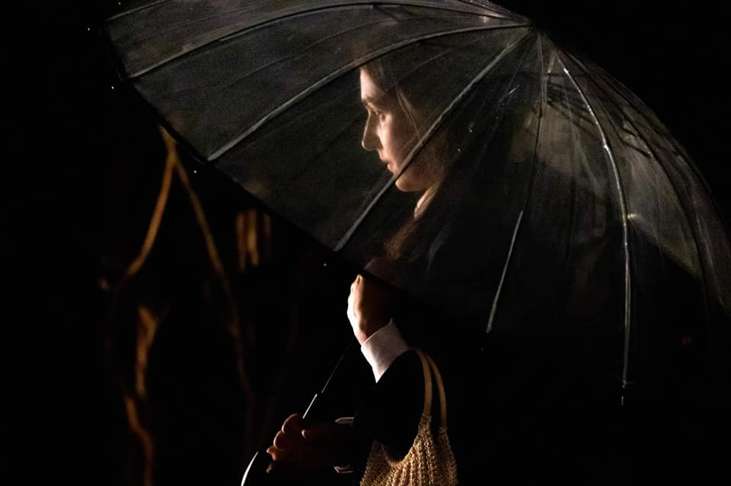
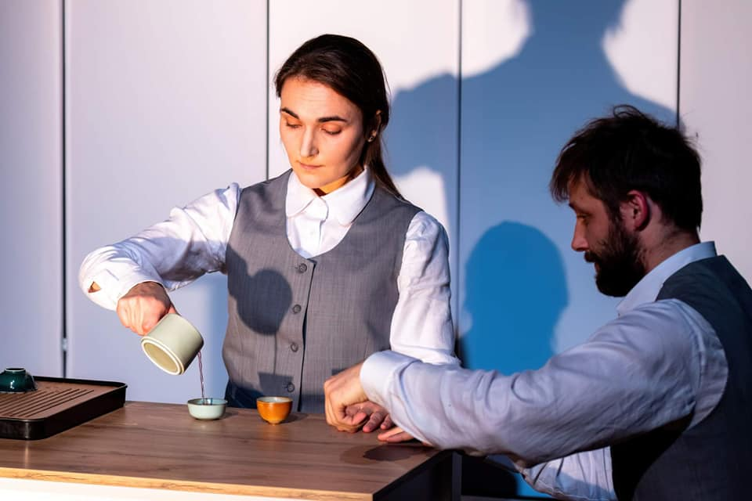
performance "Hiroshima Girl is Afraid of Thunder"

Slide 12
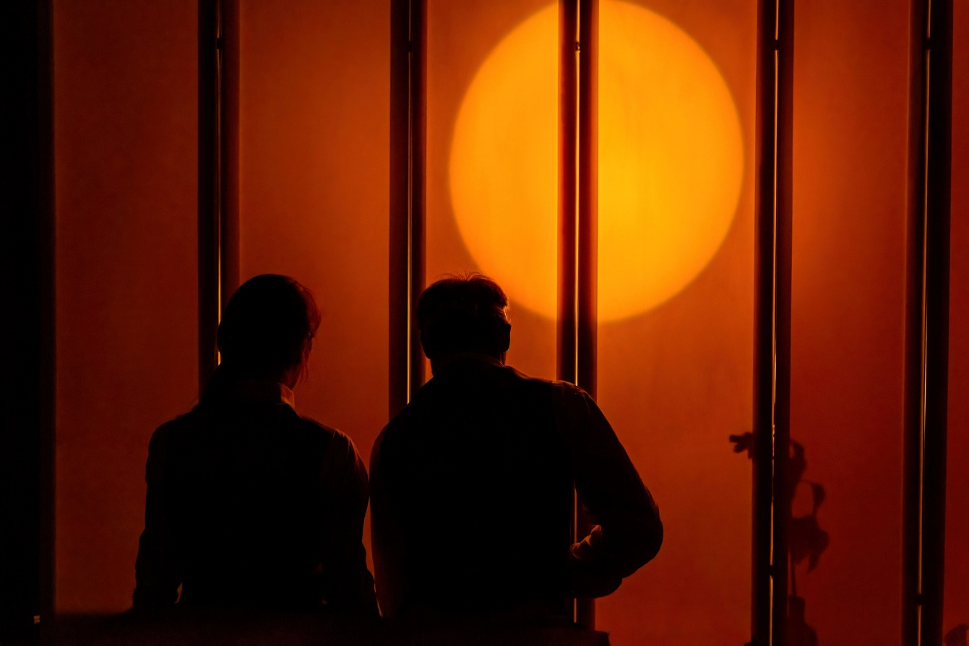
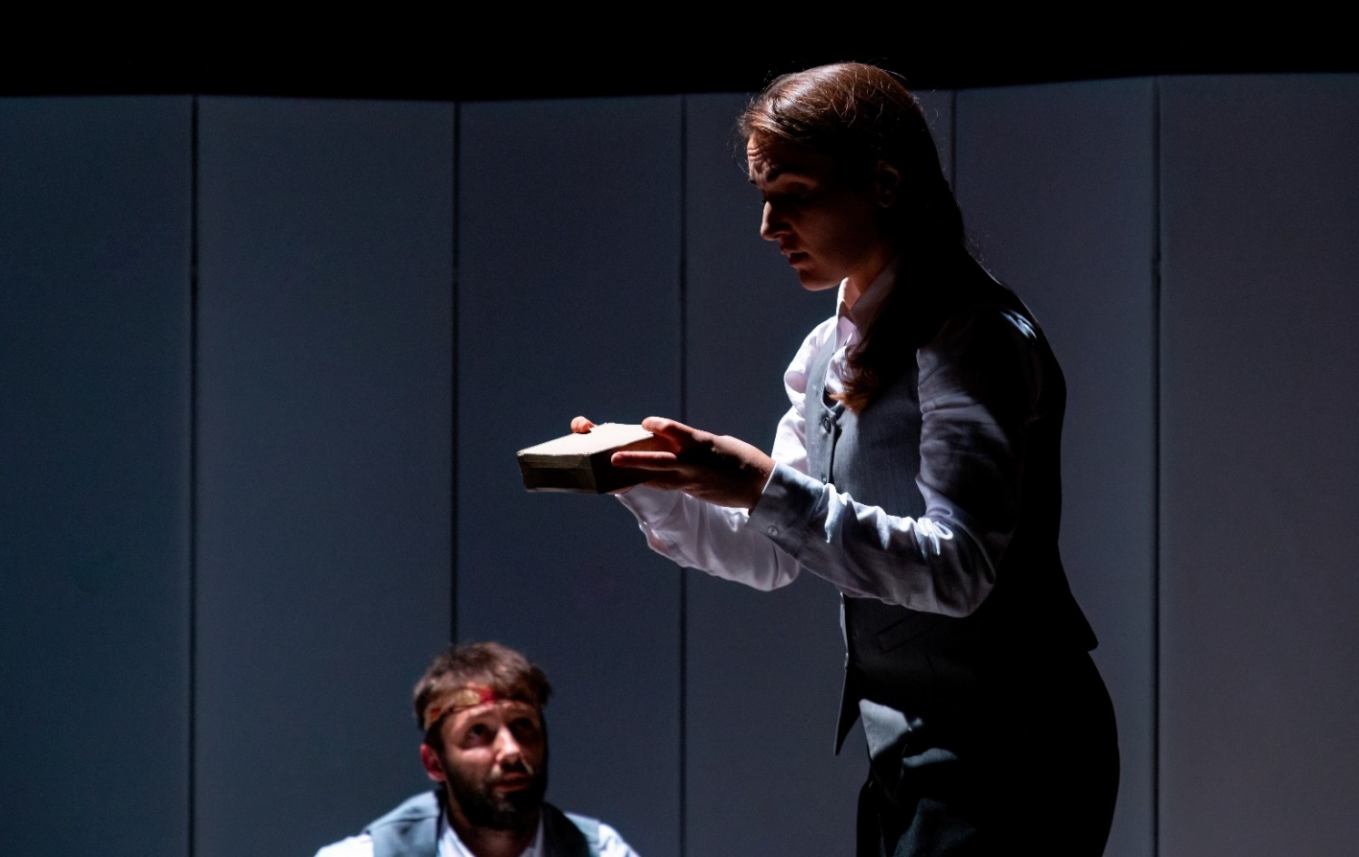
performance "Hiroshima Girl is Afraid of Thunder"

Slide 13
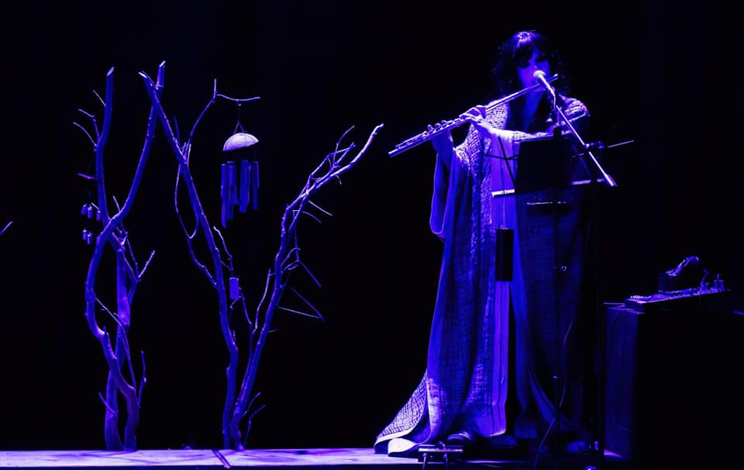
performance "Hiroshima Girl is Afraid of Thunder"

Slide 14
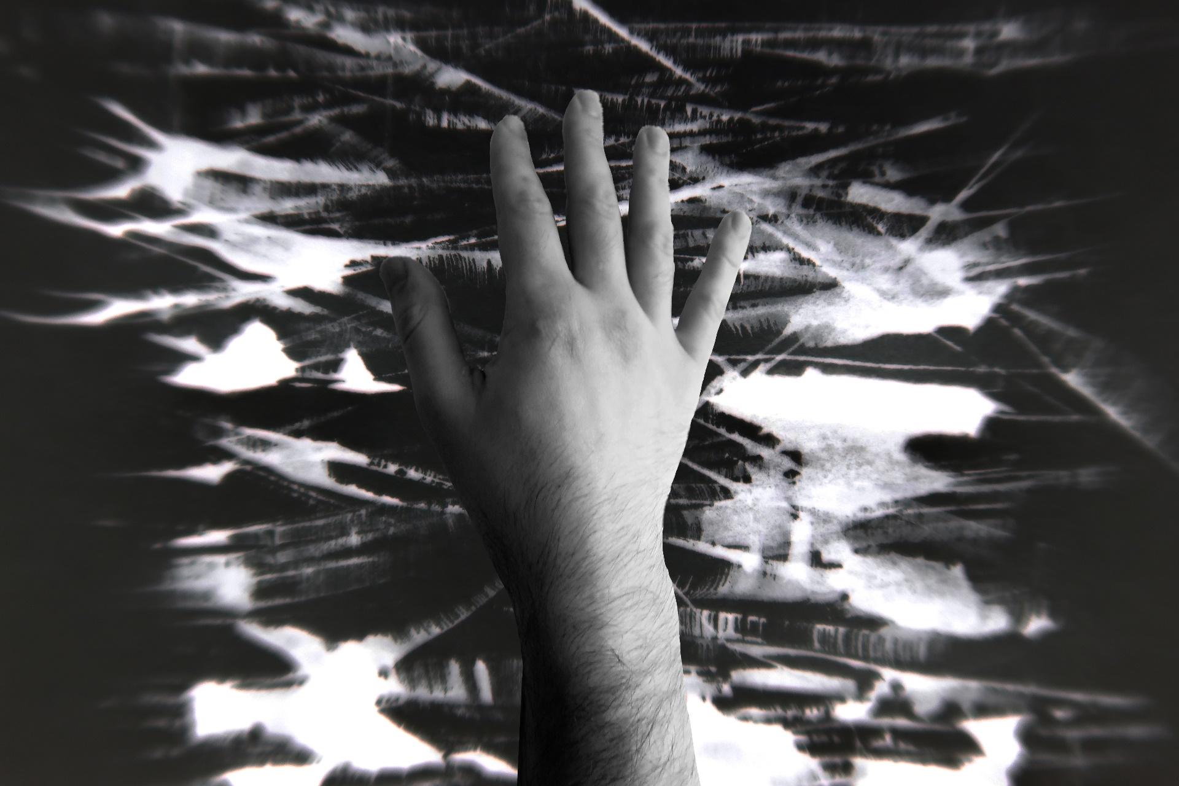

Slide 15
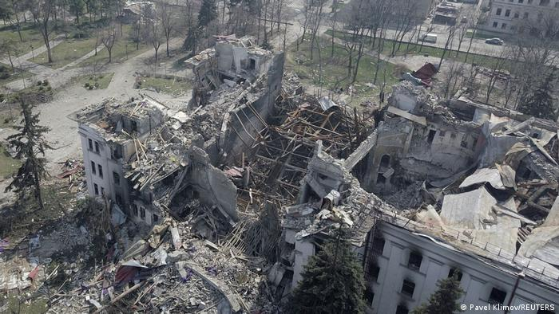
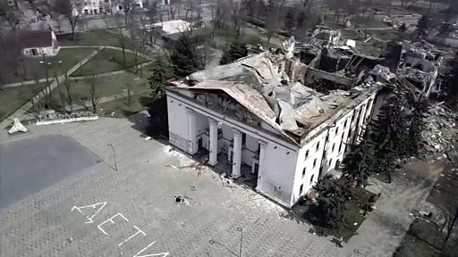
Everyone knows about the destroyed theater in occupied Mariupol

